Slide 1
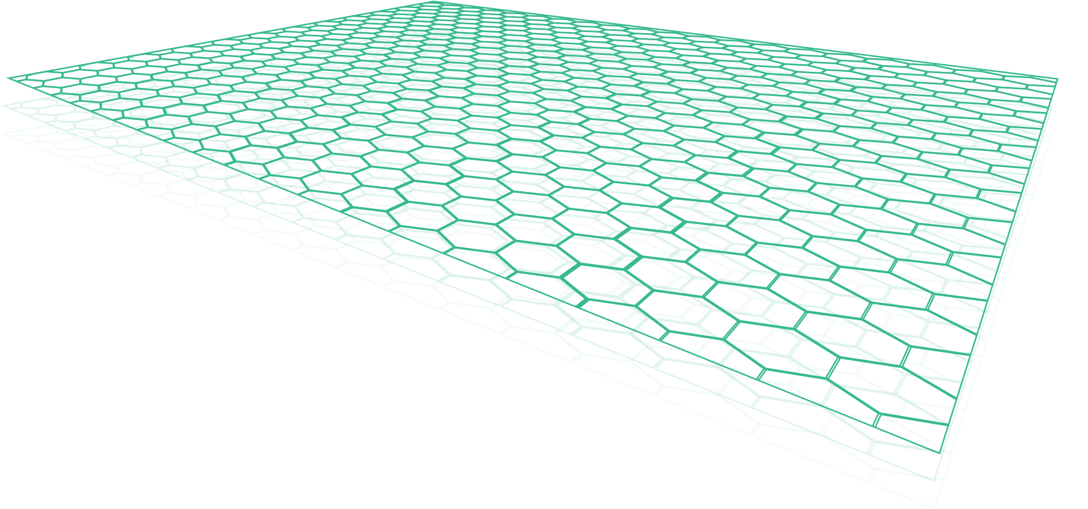
Enabling Machine Learning with Apache Beam and the Event Mesh
QCon San Francisco, November 5-7, 2018
Ken Overton, Systems Engineer
Notes:
I’m from NY and so my background leans heavily towards securities trading systems.
I’ve spent a lot of that time in the transport and networking layers making the smallest possible footprint do as many billions of events as possible during a trading session.
Not a Data Scientist, So all your Bayesian Networks, Boltzmann machines and vanishing gradient problems are utterly lost on me.
As a Plumbing Scientist I’m much more interested in the progression of these analytics tools, and what we need to really take advantage of them.

Slide 2

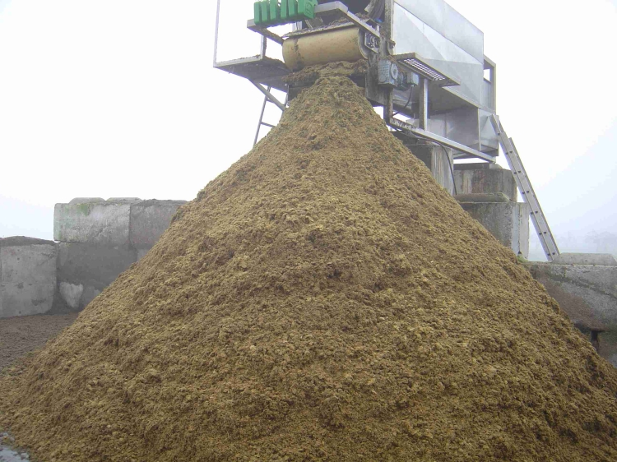
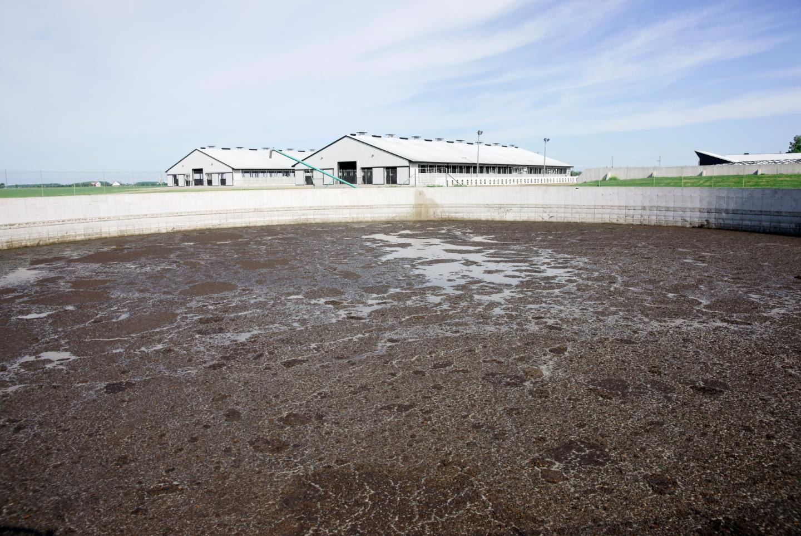
In the beginning there was data …
Notes:
<CLICK>Computing produces data, and the more computing you do the more data you produce. <CLICK>
You can laugh or groan but as a Plumbing Scientist of a certain age, I can tell you that’s how we used to view data.
At one job, I had colleagues in charge of gathering, cleaning, sanitizing, shrinkwrapping and filing it in a data warehouse. They called their app DIAPER GENIE.
We’d always known that there was value in it, with the right processing it can yield higher-value products, so we’d store lots of it but throw away even greater amounts.
It was the Google/Amazon/Facebooks that finally figured out ways to process it to extract the value.
<CLICK>Storage kept getting cheaper, so we’d accumulate lakes of historical data waiting for the right tools to filter down to the rest of us.

Slide 3


From MapReduce to batching …
MapReduce
Batching
Notes:
It started with Map-Reduce, which was great for breaking data processing apart and distributing it, but was really just the biggest, fastest SELECT and GROUPBY we’d ever seen.
People wanted a high-level API over those operations to build graphs composed of these two operations.
<CLICK>This brought us a whole range of tools to starting with Hadoop built around using these primitives over batches of data.
And that was fine when the insights you were gathering were not time-critical but that leaves out a whole range of exciting and important opportunities.

Slide 4



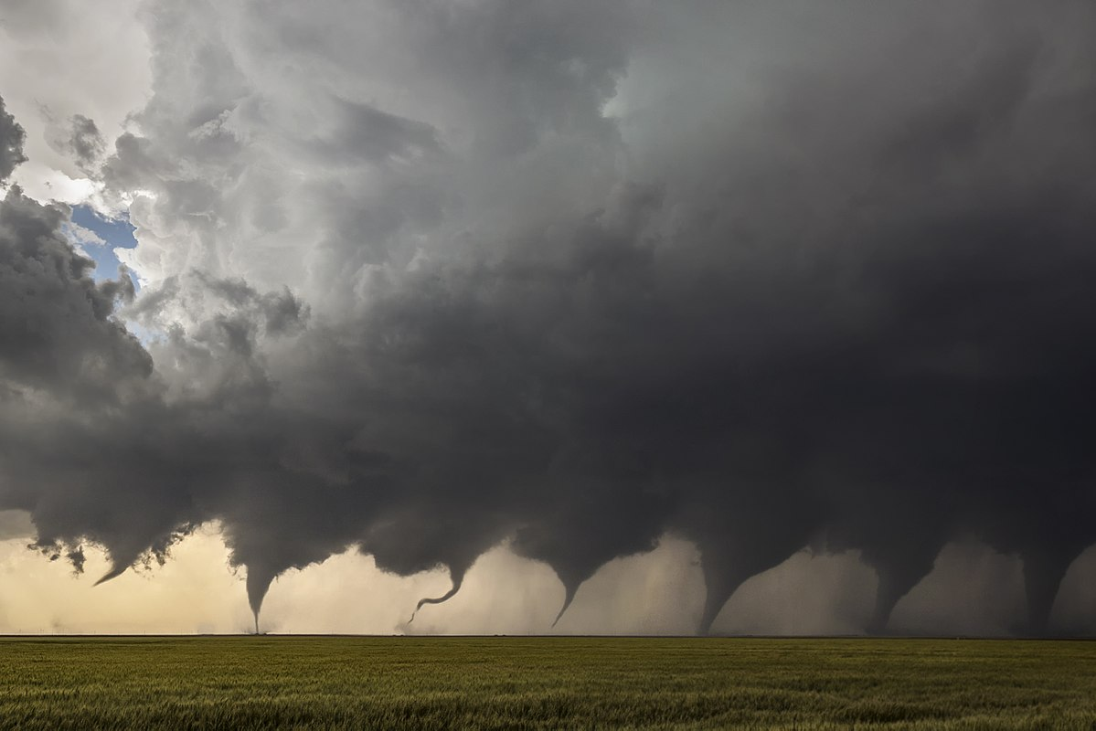

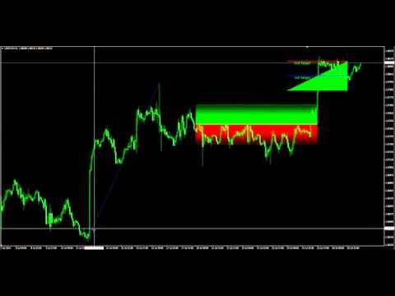


Our world is event-driven ... so are our problems
?
Notes:
Because our world doesn’t run exclusively on static Historical Data; an awful lot of it requires realtime information.
<CLICK>Static data sets are fine for distinguishing dog pics from cat pics, but
<CLICK>Fraud detection at a bank
Flight plans for the FAA
Tornado models for NOAA
Trade opportunities in finance
Retail customers walking into a competitors shop?
Detecting that 15 minutes in a hundred years when a rare plant blossoms?
Realtime Stream Processing tools make it faster and easier to build these kind of capabilities and we've only begun to identify the ways we can use them.

Slide 5

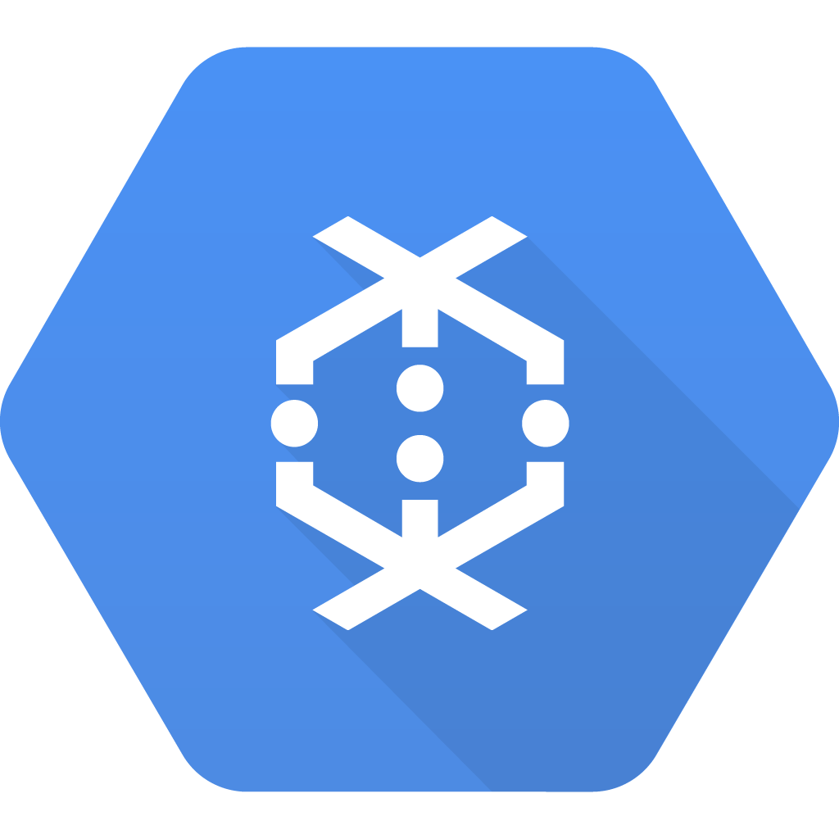




From MapReduce to batching, to streaming services
MapReduce
Batching
Streaming
Service
Notes:
The latest round of tools are ever bigger, better and faster and they remove the distinction between Batch operations and Stream operations.

Slide 6
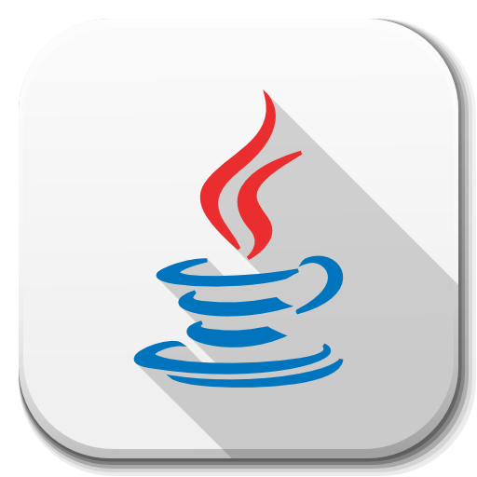
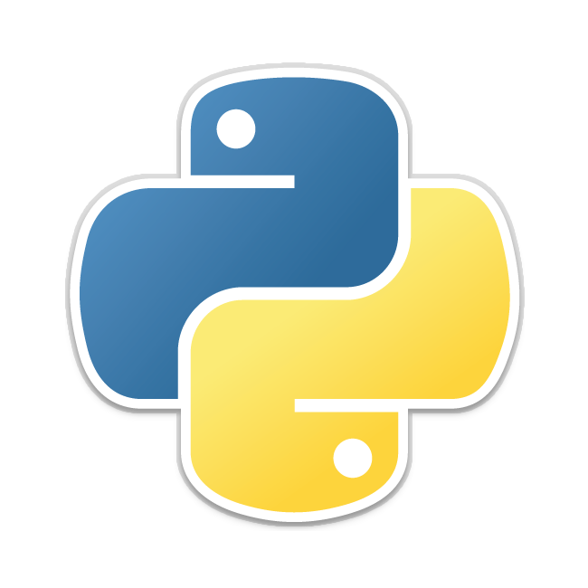

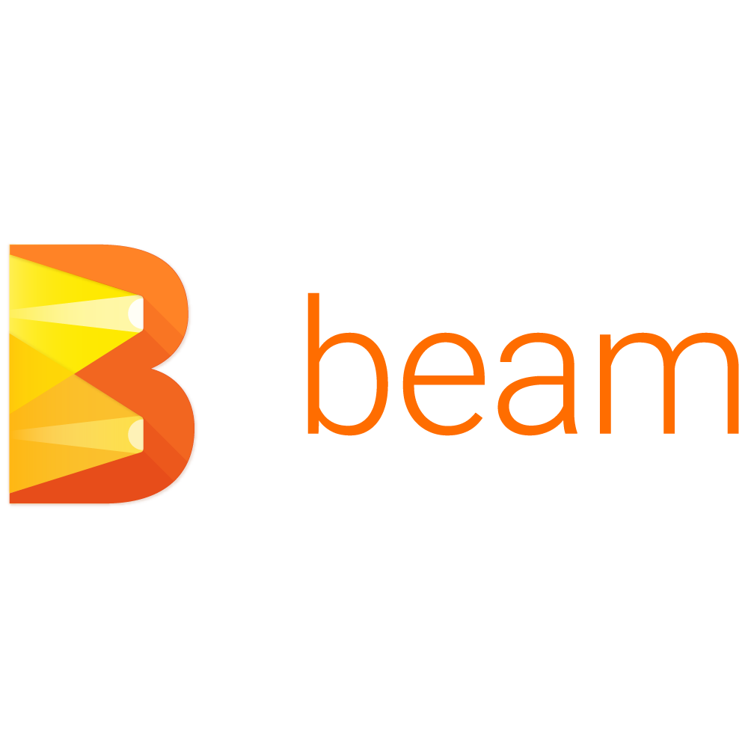



Unify access to streaming processors, support polyglot APIs
Notes:
But that leaves data scientists with a new and opposite problem – with all the different distributed batch and stream processing solutions out there you’d spend as much time porting solutions as you spent creating them.
<CLICK>Apache BEAM was conceived to solve this problem by unifying these stream processors through an abstraction layer,
<CLICK>and making them accessible across different Language APIs.
As data scientists and developers, this allows you to try Spark for a while, then see if maybe Flink does a better job. To choose the language that works the best for you.
Now I’m not a data scientist, and I don’t work on BEAM or any of these tools, but I do want to point out the decision points the BEAM team are focused on:

Slide 7
What do you look for in stream processing?

Slide 8
What do you look for in stream processing?
Dynamic: able to consume data and produce insights in realtime.

Slide 9
What do you look for in stream processing?
Dynamic: able to consume data and produce insights in realtime.
Open: support multiple processors & language APIs.

Slide 10
What do you look for in stream processing?
Dynamic: able to consume data and produce insights in realtime.
Open: support multiple processors & language APIs.
Simple: clean separation for simple deployments and scalability.
Notes:
deployment, governance, scalability

Slide 11
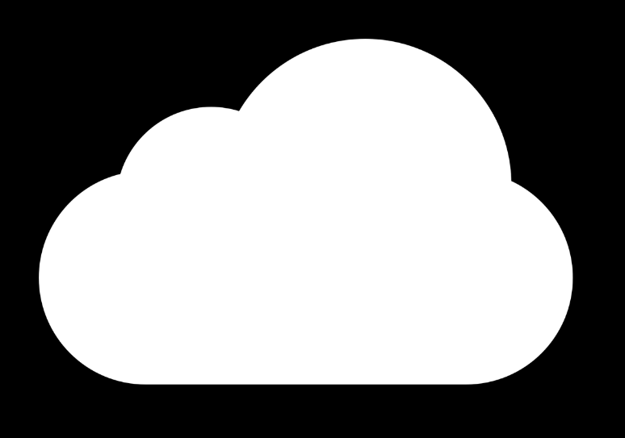
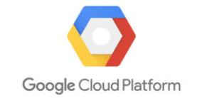
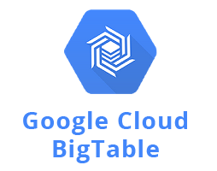

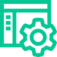


Google
Dataflow
Notes:
So now we’ve got BEAM running in GCP (just to pick one), we can hook up our preferred runners to historical data from BigTable, but also live events from our webapps that are gathering customer events.
That’s great if it’s all there, but …

Slide 12



Google
Dataflow
?
Datacenter
JMS
MQ
New Apps
Notes:
What if your data sources are elsewhere, like a corporate datacenter?
Colocated with a trading venue?
What if you need to send results back to those applications so they can leverage those insights?

Slide 13
Google Dataflow
?
Datacenter
JMS
MQ
New Apps
Notes:
You may even have solved that, but maybe you’re feeding a whole bunch of processors, and they’re consuming different combinations of sources?

Slide 14








?
Google Dataflow
?
?
?
Datacenter
JMS
MQ
New Apps
Notes:
.... And I really mean ‘different sources’?

Slide 15
?
?
Google
Dataflow
?
?
?
Datacenter
Datacenter
JMS
MQ
New Apps
Notes:
A number of points become obvious –
First is connectivity: you obviously cannot nail up a new connection every time your analytics wants data from outside it’s zone. You want a way to share that. For cases where a bunch of processors consume the same feed, you want a way to send it once over the WAN and fan it out locally.
Another thing to note is the inherent asynchrony here. Are you going to setup a separate HTTP cluster at one end of every arrow and a polling HTTP request on the other end?
A note about polling, for people who write network code, seeing polling code is like that cold floor when you roll out of the bed in the winter. It’s never a welcome sensation.
- Polling introduces latencies up to your polling interval
- Polling makes everything bursty
- Polling ties things up when you could be doing other things
- The problem of waking you up when there’s data has been solved; you have hardware interrupts! Use them!
the insights you produce are EVENTS. They have a shelf live, a value curve, introducing backlogs and latency reduces that value.

Slide 16
Separate Stream Processing from Event Distribution
Notes:
Finally, your realtime stream processing engine is not a distribution mechanism. Let it focus on what it does well, then as quickly as possible offload to something else that can concentrate on getting those events to all these interested applications spread across different environments.
<CLICK>You want applications to be able to listen for particular events by their characteristics.
And you want to be able to add and remove those listeners dynamically without bothering your Stream Processors producing them.
You want decoupling. You need an Event-Driven Architecture.

Slide 17
If you’re not embracing EDA,
you should be.

Slide 18
“By 2022…80% of new business ecosystems will require support for event processing”
Gartner: Top 10 Strategic Technology Trends for 2018: Event-Driven Model. 8. March 2018

Slide 19
Events will become the life blood of the modern enterprise, and they will need to flow freely and easily, across every environment and component of the digital enterprise.
Notes:
Image behind quote?

Slide 20
Hybrid will be the most common usage of the cloud
?
?
Google
Dataflow
?
?
?
Datacenter
JMS
MQ
New Apps
Notes:
Hybrid will be the most common usage of the cloud

Slide 21
How will you do it?

Slide 22
How will you do it?
How will you achieve uniform connectivity?

Slide 23
How will you do it?
How will you achieve uniform connectivity?
How will you scale it? Make it robust and secure?

Slide 24
How will you do it?
How will you achieve uniform connectivity?
How will you scale it? Make it robust and secure?
How will you ensure proper governance?

Slide 25


The Event Mesh
Solution
Notes:
You can do it with something we’re calling “The Event Mesh”

Slide 26
The Event Mesh is an architectural layer that routes events across your apps in a flexible, reliable and distributed manner, no matter where they are deployed.
Notes:
When I say “Event Mesh” I mean an architectural layer that is routing events across apps in a flexible, reliable and distributed manner, across all your environments.

Slide 27

Notes:
In terms of implementation an EVENT MESH is an interconnected mesh of federated EventBrokers
- It provides uniform connectivity, like a single network dial tone across these environments
- It has dynamic self-healing low-touch routing capability that decouple all your data producers and consumers
- And it has elastic scaling capability to scale up/down based on demand
Let me give you some examples where you could use it:

Slide 28









4 Ways an Event Mesh Supports your Application Architecture
Enabling Digital Transformation for IoT
Connecting and Orchestrating Microservices
Application Tier
Pushing Events from On-Premises to Cloud Services & apps
Redo as PPT Objects animations
Event
Mesh
Enabling Across
LoBs DataaaS
Event
Mesh
Event
Mesh
Notes:
#1) An Event Mesh can underpin your Microservices interconnecting them for data exchange and orchestration
#2) Connects on-prem legacy components and SORs to private or public cloud deployments, giving your Beam apps access to legacy data, and the on-prem apps access to their insights.
#3) Connects millions of IOT devices like sensors, cars, buildings or phones from the fog layer to your cloud-native apps, and even uniquely address data and commands back out to them securely.
#4) Cut across LOB silo’s to connect them via a cross-enterprise Data Service.

Slide 29
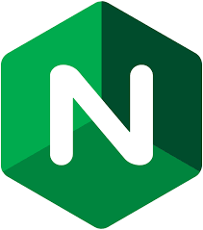



Where does the Event Mesh fit?
Request/Reply Microservices
Hybrid Microservices
Event-Driven Microservices
Request/Reply Microservices
Hybrid Microservices
Event-Driven Microservices
Request/Reply Microservices
Hybrid Microservices
Event-Driven Microservices
PaaS/CaaS/Virtualization
Request/Reply Microservices
Hybrid Microservices
Event-Driven Microservices
Network
Service Mesh
Event Mesh
Notes:
The Event Mesh’s nearest peer in systems architecture is the ServiceMesh. They are both an architectural layer, not a specific app or standard.
The Service Mesh supports complex Microservices and API services that are request/reply in nature.
The Service Mesh takes care of routing requests to the services and load-balancing across instances.
It provides connectivity, routing and fault tolerance for HTTP, where every request gets a response.
For Microservices that want to listen for events, and then act/calculate/choreograph based on them,
The EventMesh operates in a similar way:
Routing, LB, FT, Connectivity for Microservices that listen for and respond to events.

Slide 30



How does an event mesh work?
Public Clouds
PaaS
API Gateway
JMS
MQ
Notes:
An event mesh is made up of distributed event brokers linked together into a network. Each of these connections routes on behalf of all it’s client connections so can use that knowledge for WAN and network optimizations. It’s federated so the security around what can join, publish and consume events can be controlled via federated access controls and security roles.
The event mesh at scale is intelligent, self-healing and automatic.
When you operate at the scale where apps come and go, move around multiple environments, then you need a dynamic way for all that learning to happen. That's built into the EventMesh.
Let's walk through:
<CLK>App over here generating data, completely decoupled
It doesn’t care what any other app is doing because it can’t. So it's generating data, nothing will happen until something else joins and says
<CLK>"I Care about that data". Registers interest.
<CLK> the entire mesh learns
<CLK>Maybe a neighbor in another cloud registers interest. The mesh learns this and begins delivering without any changes to the producer or peers.
<CLK>It could be an API Gateway webhooking into the eventmesh,
<CLK>It no longer matters where your producer and your consumer are. With the lowest barrier to entry, they get access to a network of data sources and computing capabilities.

Slide 31







Open APIs & Protocols – Native Application Integration
Like Beam, an Event Mesh supports:
- Cross-API Interoperability
- Cross-Protocol Interoperability
- No platform or protocol lock-in
So you don’t have to bridge single-purpose systems
Objective C iOS
JavaScript
HTML5
.NET
Core 2.0
HTTP API
JMS
(1.1, 2.0)
C
REST
Python
Other
C++
Node.js
(amqp10, Rhea)
Ruby
Java
.NET
(amqpnetlite)
C++
JavaScript
Java
(SwiftMQ)
Python
.NET
Go
Perl
Native.
C
C# / .NET
JMS/JCA
Java
Node.js
Boot
Cloud
Connector
Cloud
Streams
Data Flow
Notes:
Like Beam and ServiceMesh an EventMesh supports open APIs and also open connectivity Protocols.
Which gives you:
- Cross-API Interoperability
- Cross-Protocol Interoperability
- No platform or protocol lock-in
So you don’t have to bridge single-purpose systems

Slide 32

Google
Dataflow
Notes:
I’m going to demo a very simple version of what we’ve described

Slide 33
What should you look for in an event broker?

Slide 34
What should you look for in an event broker?
Dynamic: global mesh with self-routing, self-learning, self-healing.

Slide 35
What should you look for in an event broker?
Dynamic: global mesh with self-routing, self-learning, self-healing.
Open: support open protocols & APIs.

Slide 36
What should you look for in an event broker?
Dynamic: global mesh with self-routing, self-learning, self-healing.
Open: support open protocols & APIs.
Simple: deployment, governance, scalability.

Slide 37
What should you look for in a stream processor?
What should you look for in an event broker?
Dynamic: able to consume data and produce insights in real time.
Open: support multiple processing runners & APIs.
Simple: clean separation for simple deployments and scalability.
Dynamic: global mesh with self-routing, self-learning, self-healing.
Open: support open protocols & APIs.
Simple: deployment, governance, scalability.
Dynamic.
Open.
Simple.
Notes:
The similarities are not an accident.<CLK>
There’s so much more potential for Machine Learning to change our worlds, and embracing event-driven technology is the way to do it.
Start replacing the querying, polling and blocking with eventing; it WILL make a difference.

Slide 38

World’s foremost experts in event distribution 15 Global offices
HQ in Ottawa, Canada
Notes:
My names KEN, I work at Solace.

Slide 39
Proven and trusted by:
9 of top 12 Investment banks
Top American & Indian telcos
Air traffic management around the world
Top auto makers for connected car initiatives
Singapore smart city and transportation
Notes:
We make EventBrokers that are designed for the EventMesh.

Slide 40
Thank you
Ken Overton, Systems Engineer
Visit us at booth #1234
Notes:
Happy to talk more about Event-Driven Architectures, EventMeshes, and Detroit Red Wings to anybody who stops by.

